Slide 1
Comparing serverless concurrency on AWS Lambda, AWS App Runner, and AWS Fargate
Palash

Slide 2
What is concurrency?
Why should I care about concurrency?

Slide 3


Applications aren’t just local anymore
They have a client/server architecture
Application code and content
Telemetry, data persistence, social features

Slide 4
The server must handle concurrent requests from many clients at once

Slide 5
The cloud helps you run concurrent servers.
Many client side tasks making concurrent connections to many concurrent server side tasks

Slide 6
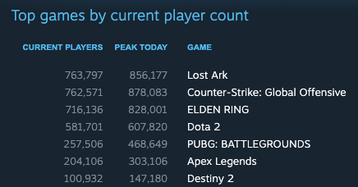
Concurrent players for several of the top online games on Steam.
All these games have a client/server architecture.
They have hundreds of thousands of concurrent users at all times!

Slide 7
How do I build an application that can handle concurrency?
From zero users to millions

Slide 8
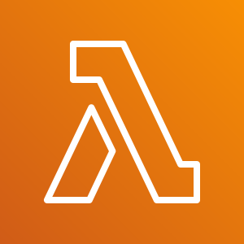

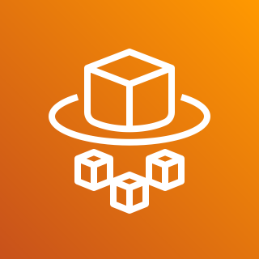
Serverless technologies help you start out small but then scale out when needed.
AWS Lambda
AWS App Runner
AWS Fargate

Slide 9
AWS Lambda
Your event handling function in the cloud

Slide 10
AWS Lambda runs your function in the cloud
exports.handler = (event, context, callback) => {
callback(null, "Hello world!");
}
Handler function

Slide 11
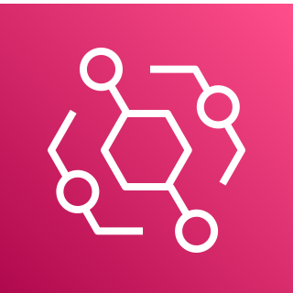
Different ways to execute the code: events
Invoke code via the AWS Lambda API
Handler function
AWS Lambda
exports.handler = (event, context, callback) => {
callback(null, "Hello world!");
}
Invoke code when a specific event happens: upload to an S3 bucket for example
Amazon EventBridge

Slide 12

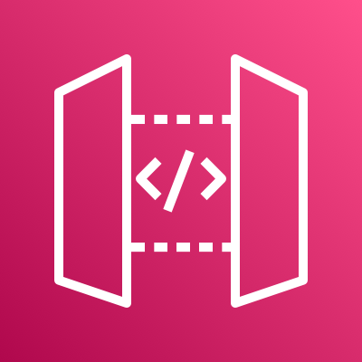
Different ways to execute the code: web requests
HTTP Request
Application Load Balancer
Handler function
exports.handler = (event, context, callback) => {
callback(null, "Hello world!");
}
HTTP Request
Amazon API Gateway

Slide 13
“When a function is first invoked, the Lambda service creates an instance of the function and runs the handler method to process the event. After completion, the function remains available for a period of time to process subsequent events. If other events arrive while the function is busy, Lambda creates more instances of the function to handle these requests concurrently.”
- AWS Lambda documentation

Slide 14
AWS Lambda lifecycle
Cold Start
Init Code
Invoke Function Code
Downloading your code and loading it up for execution in its own isolated execution sandbox.
Any setup code outside your handler function.
Running your handler code, waiting for it to respond back with a result.

Slide 15
Each function only handles one invoke at a time
2 concurrent requests
3 concurrent requests
1 request
Cold Start
Function execution
Function Instance 1
Function Instance 2
Function
Instance 3
Cold Start
Cold Start

Slide 16
Concurrency deep dive
What is actually happening during a request?

Slide 17
What is my application actually doing?
Handler Invoke (120ms)
Validate Input Payload (1ms)
Insert Row in Database, wait for response (10ms)
Handle DB response (1ms)
Call to downstream service and wait for response (100ms)
JSON serialize (8ms)
Many modern workloads are full of I/O operations

Slide 18
Handler Invoke (120ms)
What is my application actually doing?
Validate Input Payload (1ms)
Insert Row in Database, wait for response (10ms)
Handle DB response (1ms)
Call to downstream service and wait for response (100ms)
JSON serialize (8ms)
Running
Waiting
Running
Waiting
Running
I/O heavy workloads often spend more time waiting than running CPU instructions

Slide 19

Most modern application frameworks make it possible to handle multiple concurrent requests in a single application process
Validate Input Payload (1ms)
Each second has 1000ms for a CPU core to do work.
Grab more work off the event loop whenever we are waiting on I/O
Event Loop
Handle DB response (1ms)
JSON serialization (8ms)

Slide 20
Instead of doing nothing while waiting, grab another event and do some work while we wait
Time
Request 1
Validate Input Payload (1ms)
Waiting for DB
Handle DB response (1ms)
Waiting for downstream service
JSON serialization (8ms)
Validate Input Payload (1ms)
Handle DB response (1ms)
Waiting for downstream service
JSON serialization (8ms)
Request 2
Waiting for DB
The event loop schedules work into all 1000ms of time per second.
A single application process can keep the CPU core busy by doing other work (like answering another HTTP request) while it waits on I/O

Slide 21
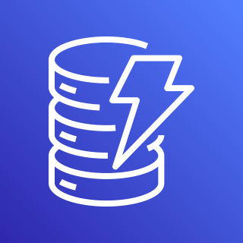
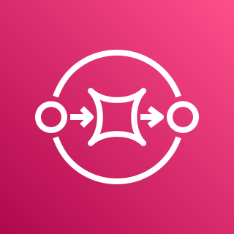

You can do batch calls with AWS services
(Not an exhaustive list)
Amazon DynamoDB
Amazon Simple Queue Service (Amazon SQS)
Amazon Simple Notification Service (Amazon SNS)
BatchWriteItem
SendMessageBatch
PublishBatch
BatchGetItem

Slide 22
Downsides of concurrency: What happens if you have too many requests per second?
Response Time
Code to run
Code to run
100%
CPU
Code to run
Code to run
Code to run
Event Loop
Code to run
50%
Memory
Code to run
Code to run
Code to run
Code to run
0%
Work starts queueing up
As CPU saturates the response time skyrockets

Slide 23
Solution: load balance across multiple copies of the application process
Processes could be both running on the same physical machine and sharing separate cores of a multicore machine.
Or they could be on their own machines.
Application Container
Event Loop
Load Balancer
Application Container
Event Loop

Slide 24
AWS App Runner
Each copy of your application handles many concurrent requests

Slide 25
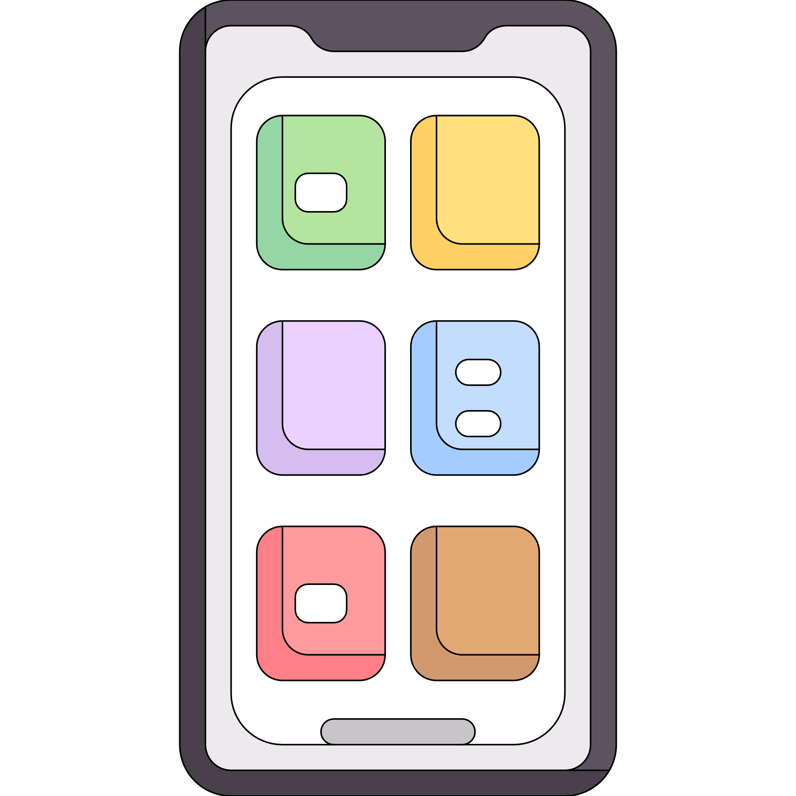
AWS App Runner manages horizontal scaling for you
AWS = Fully managed by AWS You = Your responsibility to manage
Scaling (AWS)
MicroVM (AWS)
Application Container
Event Loop
Ingress and Load Balancing (AWS)
Application code (You)
Client code (You)

Slide 26
You
Your client side code sends requests to the endpoint for an AWS App Runner service.
Envoy Proxy Load Balancer
The endpoint goes to a fully AWS managed Envoy Proxy load balancer
AWS
Each instance of your application container has its own concurrency limit and overflow queue.
Overflow Queue
Concurrent Requests Limit
You
Application Container
Your application receives concurrent requests, up to the limit you defined, and processes them
Event Loop

Slide 27
You
Envoy Proxy Load Balancer
AWS
Overflow Queue
Overflow Queue
429 Too Many Requests
Concurrent Requests Limit
Concurrent Requests Limit
You
Application Container
Application Container
Your application is protected from traffic bursts
Event Loop
Event Loop

Slide 28
AWS Fargate
Serverless containers, but you manage scaling and concurrency

Slide 29
AWS Fargate provides microVM’s for your containers
AWS = Fully managed by AWS You = Your responsibility to manage
Scaling (You)
MicroVM (AWS)
Application Container
Event Loop
Ingress and Load Balancing (You)
Application code (You)
Client code (You)

Slide 30



You use an orchestrator to configure and manage your own customized deployment on AWS Fargate
Configuration
Ingress and Load Balancing
Developers
Orchestrator
“Run 10 copies of my app, register in this LB, scale up if CPU goes over 80%”
Deployments and scaling
AWS Fargate
Application metrics

Slide 31
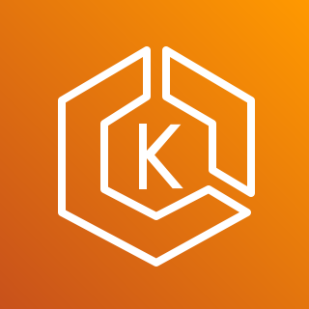
AWS Fargate gives you more choices
Fully AWS managed API. Only pay for the Fargate tasks.
Amazon Elastic Container Service
API
AWS managed open source deployment. Pay for your personal deployment of the control plane
Amazon Elastic Kubernetes Service

Slide 32
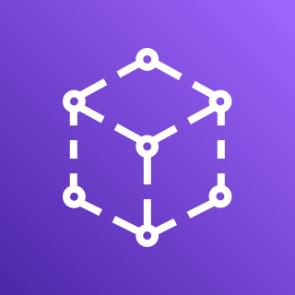
AWS Fargate gives you more choices
Application Load Balancer
Level 7, HTTP(S)
Network Load Balancer
Level 4
Ingress and Load Balancing
AWS App Mesh
Gateway
Amazon API Gateway

Slide 33
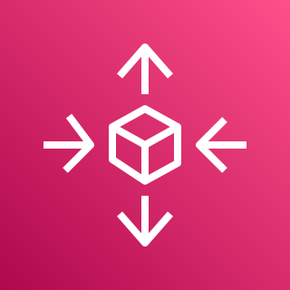

AWS Fargate gives you more choices
Step Scaling
Target Tracking
Scheduled scaling
AWS Auto Scaling
Scaling
Scale based on concurrency, CPU utilization, available messages in an SQS queue, or any other custom metric
Amazon CloudWatch

Slide 34
Conclusion

